Slide 1
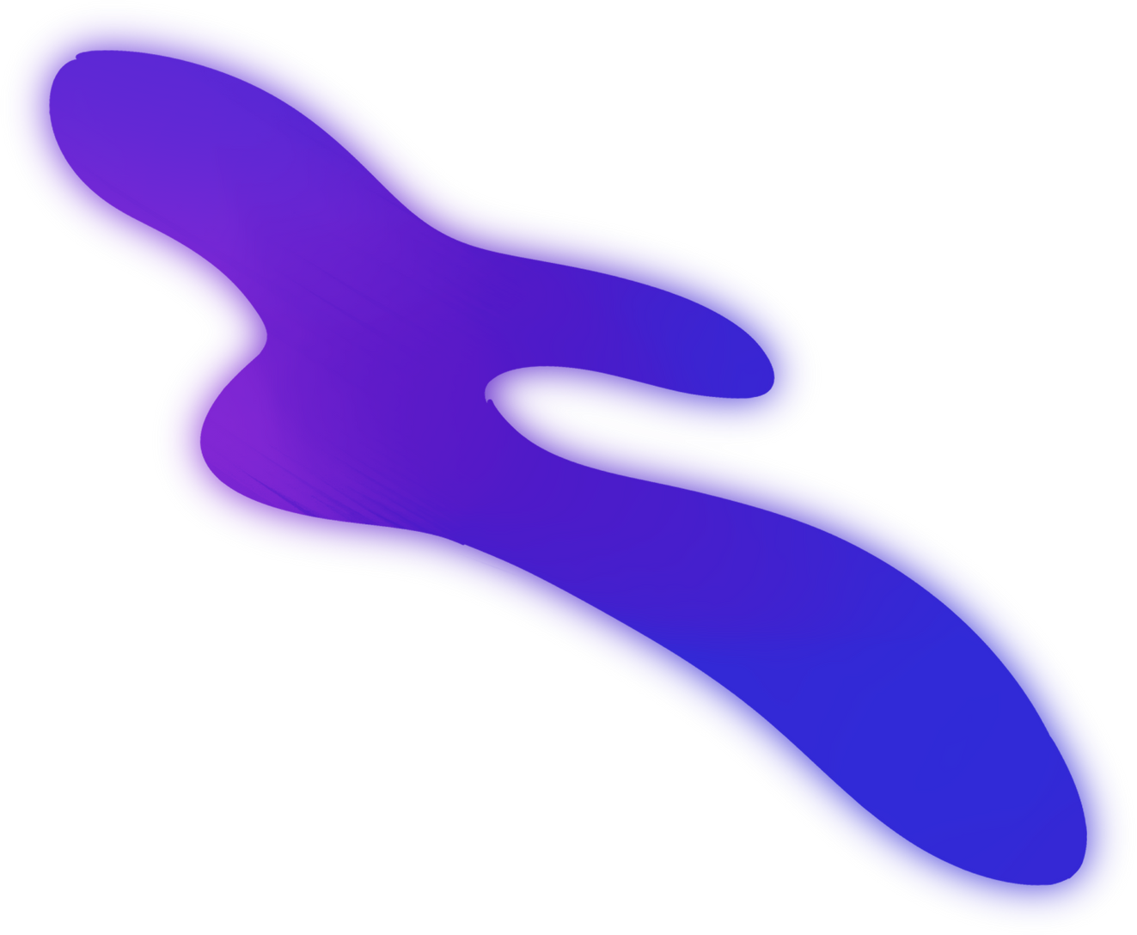


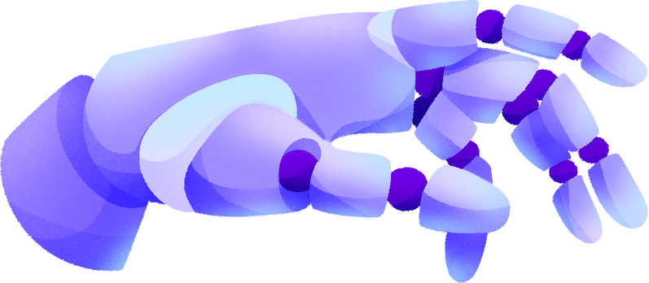


SEMANTIC CONSTRAINTS IN ARTISTIC STYLE TRANSFER
By Srijan Dutta & Shaon Ghosh

Slide 2
TABLE OF CONTENTS
Introduction
Style Transfer
What We Aim
Neural Style Transfer
Feed-Forward Convolutional Neural Network
Instance Normalization
Clip Styler
Comparison Analysis
Conclusion

Slide 3

INTRODUCTION
Generative AI, short for Generative Artificial Intelligence, is a branch of artificial intelligence (AI) that focuses on creating systems capable of generating content, data, or outputs that mimic human creativity and imagination.
Applications
It has a wide range of applications like:
Text Genration
Image Generation
Music Generation
Content Creation
Style Transfer

Slide 4


STYLE TRANSFER
What is Style Transfer
Style transfer is a technique in the field of computer vision and image processing that allows the application of artistic styles from one image or artwork to another while preserving the content and structure of the target image.
Semantic Constraints
Semantic constraints refer to limitations or guidelines placed on a system, process, or algorithm to ensure that it considers and maintains the meaningful, contextually relevant aspects of the information it processes.

Slide 5
WHAT WE AIM
This paper aims to provide a better understanding of the working of deep learning models in Generative AI along with the use and impact of semantic constraints in these models. Here a detailed description is provided of how these models differ and where they might be implemented.

Slide 6




NEURAL STYLE TRANSFER
Neural style transfer (NST) is a technique that uses deep neural networks to manipulate images or videos. NST takes two images and blends them together to create a new image. The new image looks like the content image, but is painted in the style of the style reference image.
01
Three key images are utilized in - a content image (C), a style image (S), and an initial generated image (G). A pre-trained neural network, such as VGG-19, is employed to dissect these images, capturing their content and style features.
02

Slide 7
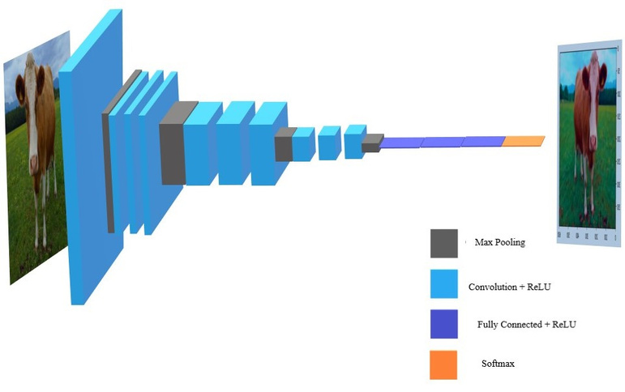
NEURAL STYLE TRANSFER
VGG-19 consists of 19 layers, including 16 convolutional layers followed by max-pooling layers and then three fully connected layers. The final layers of VGG-19 are fully connected layers. These layers take the high-level features extracted by the convolutional layers and use them for image classification.

Slide 8
FEED-FORWARD CONVOLUTIONAL NEURAL NETWORK
A feed-forward neural network is a type of artificial neural network where the nodes' connections do not form a loop. In a feed-forward network, all information flows in a forward manner only.
01
A feed-forward network connects every pixel with each node in the following layer, ignoring any spatial information present in the image. A convolutional architecture looks at local regions of the image.
02

Slide 9
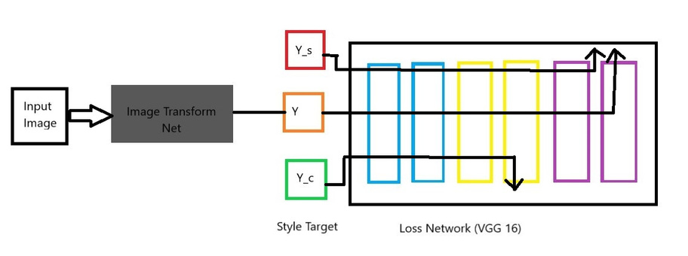
FEED-FORWARD CONVOLUTIONAL NEURAL NETWORK
The Feed-Forward CNN is a deep neural network architecture specifically crafted for style transfer tasks. It usually consists of convolutional layers, each responsible for capturing different features of the input image. Unlike traditional neural networks that require iterative backpropagation and optimization during inference, Feed-Forward CNNs used in style transfer are designed for single-pass inference.

Slide 10
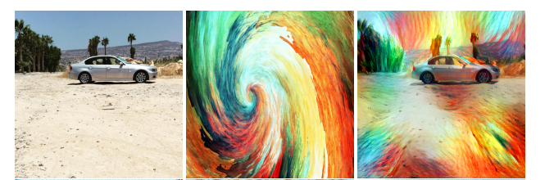
INSTANCE NORMALIZATION
AdaIN
we demonstrate that by replacing batch normalization with instance normalization it is possible to dramatically improve the performance of certain deep neural networks for image generation. The result is suggestive, and we are currently experimenting with similar ideas for image discrimination tasks as well.

Slide 11
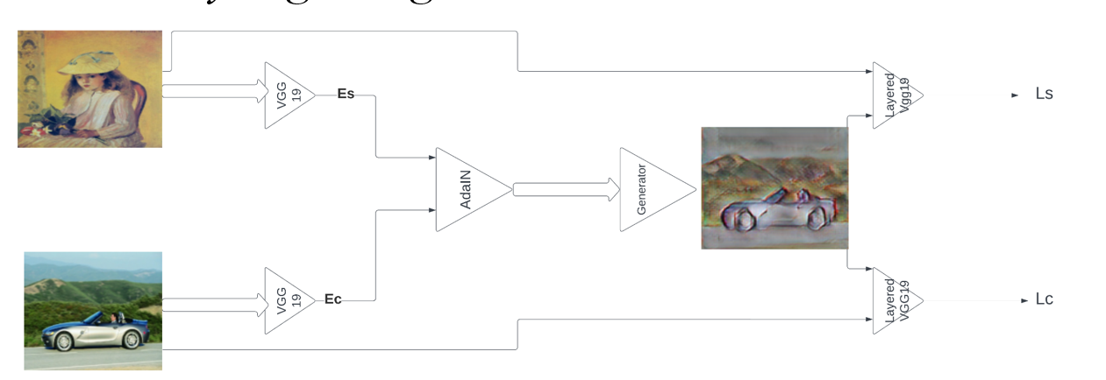
AdaIN
Adaptive Instance Normalization (AdaIN) dynamically adjusts style transfer by incorporating style information from a separate image. Unlike fixed learnable parameters in standard Instance Normalization, AdaIN utilizes the mean and standard deviation operations on both content and style tensors for flexible and versatile stylization. This adaptability enhances artistic transformations, allowing quick fine-tuning and integration into neural style transfer architectures. While powerful, AdaIN may incur higher computational costs, requiring a balance between content preservation and style adaptation for optimal results.
Instance Normalization

Slide 12
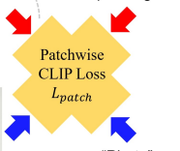
CLIP STYLER
Existing neural style transfer methods require reference style images to transfer texture information of style images to content images. However, in many practical situations, users may not have reference style images but still be interested in transferring styles by just imagining them. In order to deal with such applications, we propose a new framework that enables a style transfer ‘without’ a style image, but only with a text description of the desired style. Using the pre-trained text-image embedding model of CLIP, we demonstrate the modulation of the style of content images only with a single text condition. Specifically, we propose a patch-wise text-image matching loss with multiview augmentations for realistic texture transfer. Extensive experimental results confirmed the successful image style transfer with realistic textures that reflect semantic query texts.

Slide 13
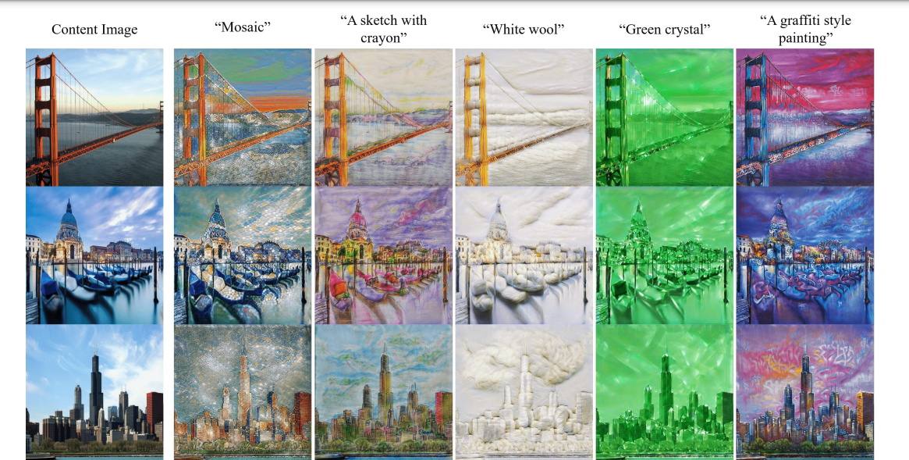
CLIPSTYLER
WITH A SINGLE TEXT CONDITION
A content image is given as an input and a single text condition is given to generate
an output image. The text condition needs to be conditions that an act as a painting style . Then we get an output image that has the essence of painting style of the text condition.

Slide 14
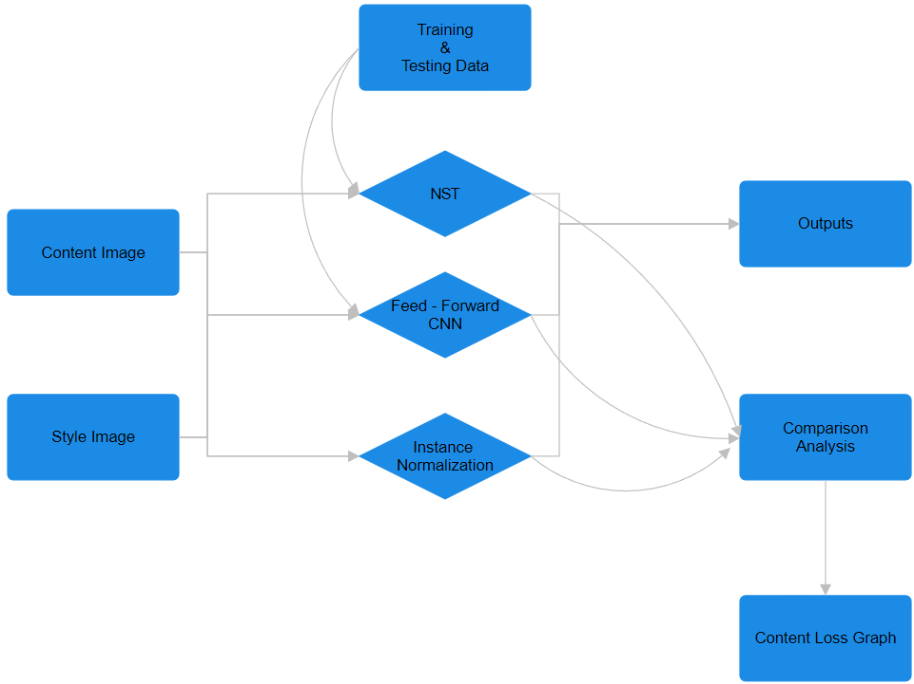
COMPARISION STUDY IN DETAILS
This flowchart describes our work plan and methodologies regarding them. We will get to see the results and conclusions in the next slide.

Slide 15
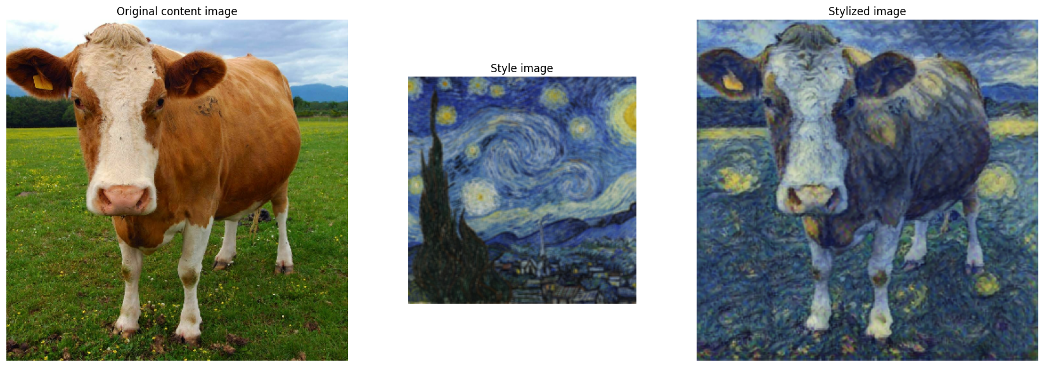
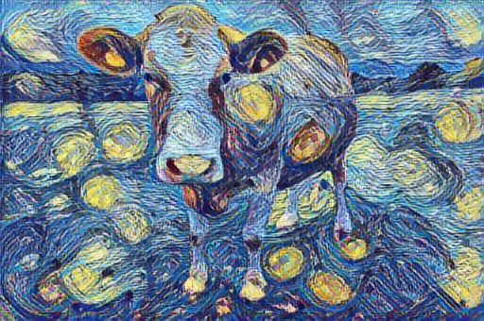
RESULTS
This model takes the most amount of time but provides images that are most accurate according to content loss. Its loss function is quite simple but cannot provide great results if used in real time applications.
NEURAL NETWORK USING VGG-19

Slide 16
RESULTS
Here we use a feed forward convolutional neural network as explained in the previous slide to retrain the already trained image in a feed forward loop. It is used in real time applications.
FEED FORWARD NEURAL NETWORK

Slide 17
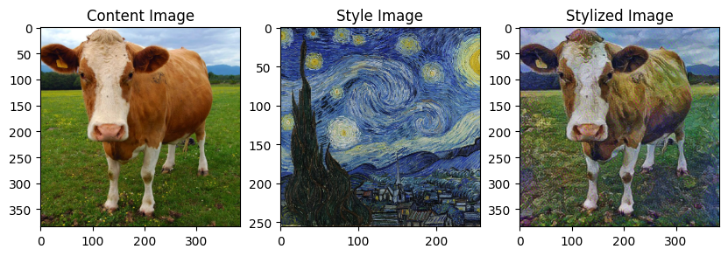
RESULTS
Here we use a pre existence neural style transfer method and add a layer of adaptive instance normalization that normalizes the images on a range. This is useful in batch processing and fast stylization.
INSTANCE NORMALIZATION(ADAIN)

Slide 18
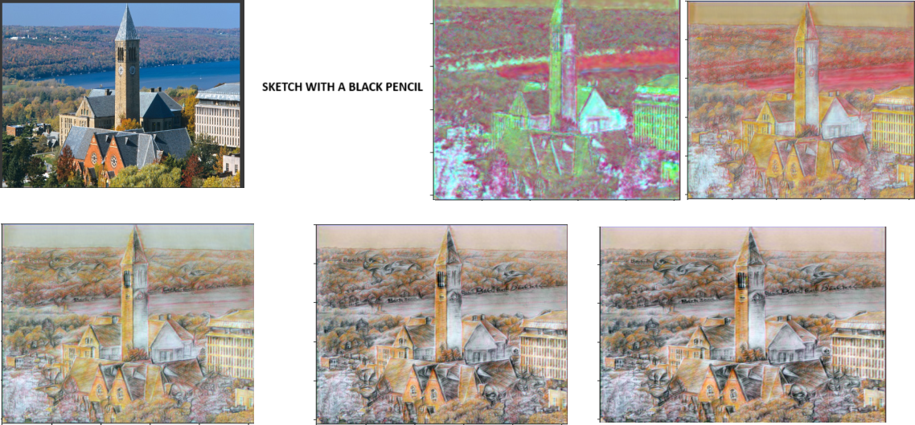
RESULTS
Here we use a single text condition that acts a style image. we don’t insert a style image as such. The text condition converts into a base level style image as such and gives us an stylized image at a relatively faster speed. It is a new technology.
CLIP STYLER

Slide 19
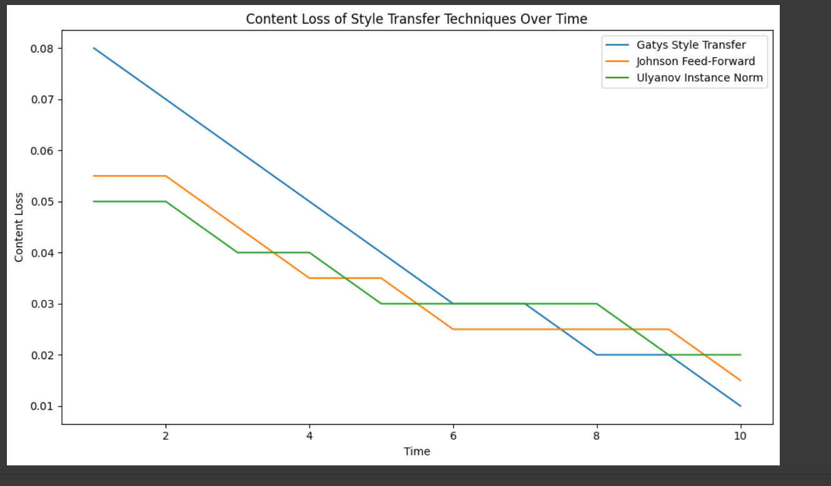

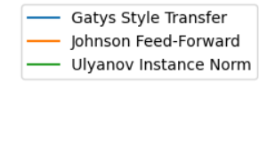
COMPARISION ANALYSIS
"The graph compares content loss over time for three style transfer techniques: Gatys, Johnson, and Ulyanov. Gatys rapidly converges to low content loss, Johnson maintains moderate levels consistently, and Ulyanov shows a gradual decrease. This visualization highlights the distinct trade-offs between speed and quality for each technique, providing insights into their unique characteristics."
INDEX

Slide 20
CONCLUSION
In conclusion, semantic constraints play a pivotal role in various fields, including natural language processing, computer vision, artificial intelligence, and knowledge representation. However one of the challenges of artistic style transfer is that it can be difficult to control the results. The style of the original image may not always be transferred accurately to the target image. Additionally, artistic style transfer can be a computationally expensive process.

Slide 21

THANK YOU!

